Slide 1
Towards Batch-Processing on Cold Storage Devices
بسم الله الرحمن الرحیم
Ali Hadian, Thomas Heinis

Slide 2
Data – Size and temperature!
Data grows in size
Most of the data gets COLD
Infrequently accessed
Objective:
High Performance
Low Cost
➔ Price/Performance tradeoff
* Image retrieved from: https://goo.gl/o7GGcp

Slide 3
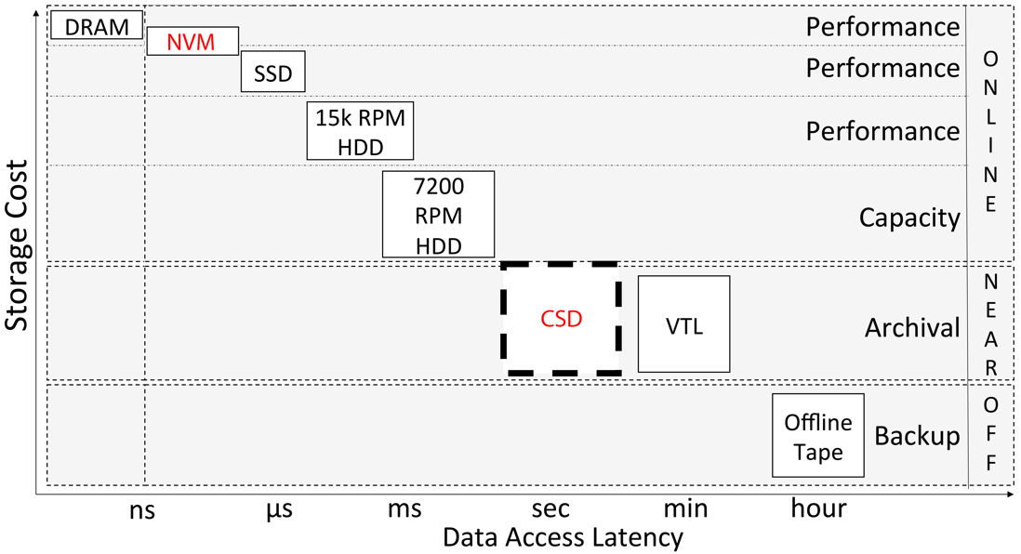
Storage Devices
Storage tiers:
Performance (Online)
Capacity (Online)
Archival (Nearline)
Backup (Offline)
Based on Borovica-Gajic et al,
"Cheap Data Analytics using Cold Storage Devices", VLDB'16

Slide 4
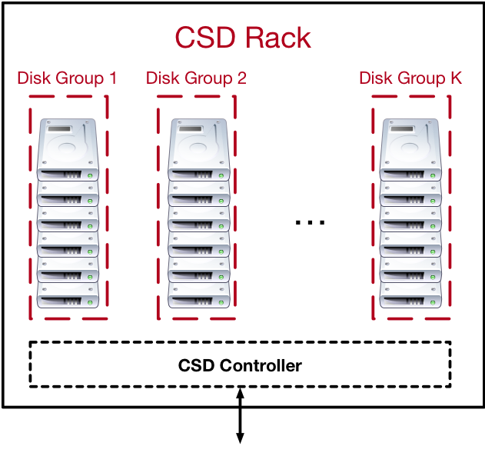
Cold Storage Device
Limited power & cooling facilities
Only one disk group is spun up
E.g. in Pelican: 1/K^{th} = 8% of disks are active
Disk switch latency: 10-30 seconds
Example Systems:
Microsoft Pelican
OpenVault's Knox storage
Facebook Cold Storage
Amazon Glacier
Workload: Write Once – Read Occasionally (WORO)
Can we process data in CSD?

Slide 5
BATCH PROCESSING on CSD
Common batch processes on cold data:
Massive-scale Group-by / Join
[Near]-duplicate detection
Data Localization
In-place Map-Reduce
Data Partitioning
Partition items into K groups
Distribute between K disk groups
group_ID = Partitioner(element)
Various Partitioners:
Hash, Range, map(), etc.
How do we flush the data?

Slide 6
Flushing
Buffer is full → flush → into which disk group?
Naïve approach: Many switches

Slide 7
Buff-Pack
Greedy approach:
Try to maximize throughput (GB/sec) in the next step(s):
Intuition:
Flush into the current disk group to avoid switching, if possible.
Otherwise: switch to disk group with the largest buffer

Slide 8
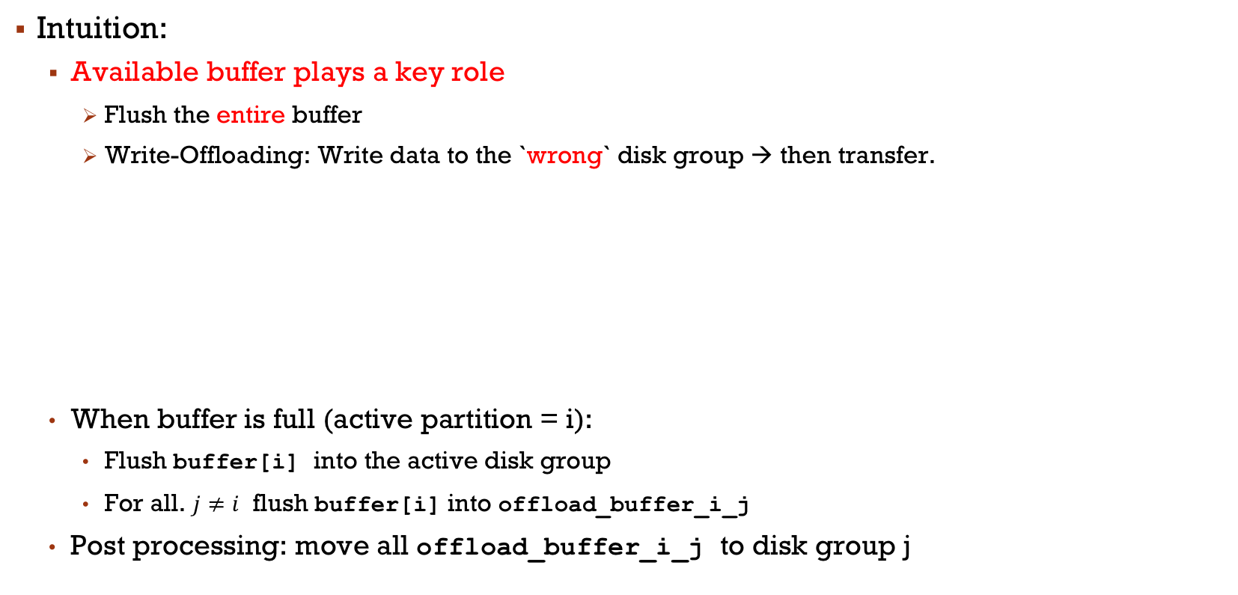
Off-Pack
Intuition:
Available buffer plays a key role
Flush the entire buffer
Write-Offloading: Write data to the `wrong` disk group → then transfer.
When buffer is full (active partition = i):
Flush buffer[i] into the active disk group
For all. $j≠i$ flush buffer[i] into offload_buffer_i_j
Post processing: move all offload_buffer_i_j to disk group j

Slide 9
Which algorithm? - Analytical Model
Estimates for the number of disk group switches and computation time of each algorithm
Intuition:
Off-Pack: Fewer switches, more read/write
Off-Pack is better for a
Smaller buffer ↓
Higher # disk groups ↑
Higher throughput ↑
$$T_{total}=T_{switch}+T_{seek}+T_{read}+T_{write}$$

Slide 10
Experiments – CSD Spec.
Configuration
Parameter | Value
Buffer size | 8 GB
# Disk groups | 12
Dataset size | 100 TB
Throughput | 1 GB/sec
Group switch latency | 10 sec

Slide 11
Experiments – buffer & Data
Configuration
Parameter | Value
Buffer size | 8 GB
# Disk groups | 12
Dataset size | 100 TB
Throughput | 1 GB/sec
Group switch latency | 10 sec

Slide 12
Experiments – Skew
Configuration
Parameter | Value
Buffer size | 8 GB
# Disk groups | 12
Dataset size | 100 TB
Throughput | 1 GB/sec
Group switch latency | 10 sec

Slide 13
Conclusion
CSD is a cost-effective archival storage
Batch data analytics on CSD-resident data
Data partitioning
Our Results:
Buff-Pack: Ordering flushes to reduce disk group switches
Off-Pack: Write offloading for data consolidation
Analytical model: Accurately predicts performance and can be used to choose the best method
The choice of the best method only depends on the hardware

Slide 14
Thanks!

